Slide 1
COVID 19 -Boosters and Childhood Vaccinations
Chrystal Wittcopp, MD
Assistant Professor of Pediatrics, UMASS Medical School
Medical Director, Baystate General Pediatrics
140 High Street Springfield MA

Slide 2
No disclosures

Slide 3
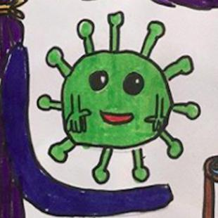
A child’s perspective and lessons in humility

Slide 4
How do vaccines work?
Every virus has signature features (spike proteins) on its surface that can trigger your immune system.
All vaccines train our immune systems to create proteins that fight a specific disease, known as ‘antibodies
Once antibodies are established the response is much faster and more effective than the first time around because the memory cells are at the ready to pump out antibodies against a specific disease (antigen).
Some vaccines contain weakened or inactive parts of a particular organism (antigen) that triggers an immune response within the body. Newer vaccines (mRNA) contain the blueprint for producing antigens rather than the antigen itself.

Slide 5
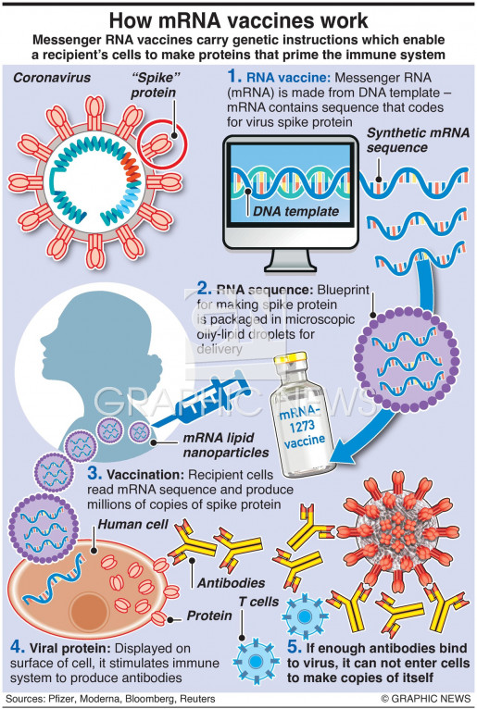

Slide 6
Johnson and Johnson vaccine – a vector vaccine
The Johnson & Johnson product is an adenovirus vaccine or a viral vector vaccine.
It delivers the virus' DNA to your cells to make the spike protein. An adenovirus acts as a delivery vehicle used to carry the coronavirus genetic material (DNA) to cells
Cells then make a spike protein
After your cells produce the spike protein, your immune system creates antibodies toward the spike protein, protecting you from infection.

Slide 7
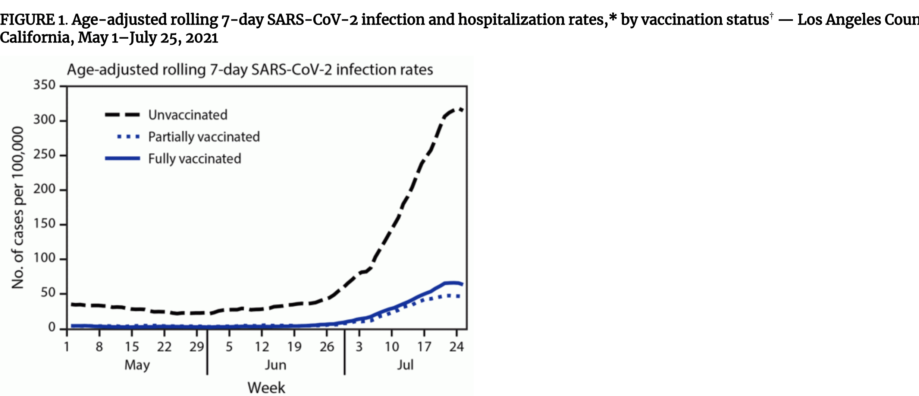
The COVID-19 vaccines work

Slide 8
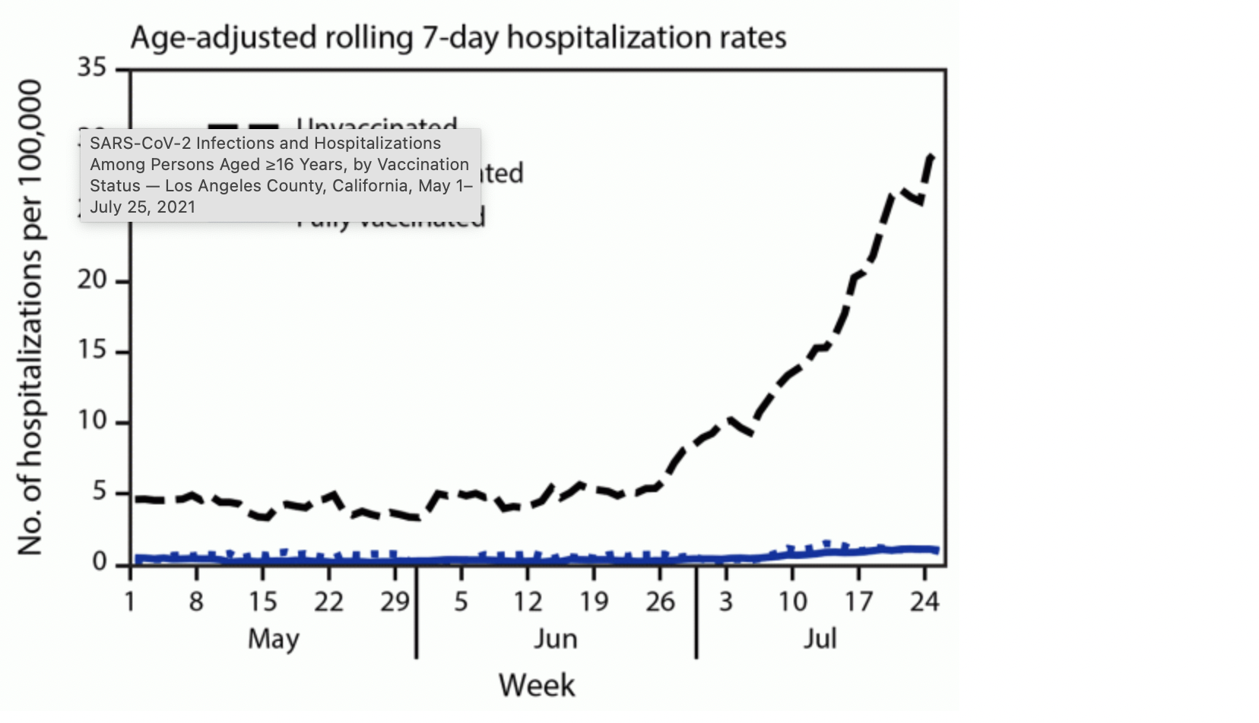

Slide 9
Why do we need a booster?
With the original dose, the immune system is primed to recognize and produce antibodies against the virus it was created to defend.
Booster shots are administered to remind the body’s immune system about the virus it needs to defend against. This improves or gives the immune system a boost.
This approach has been used with lots of other vaccines, such as hepatitis A, hepatitis B, meningitis vaccines, tetanus vaccinations etc. Booster doses are meant to remind the immune system how to respond to viruses or bacteria, so a response can be hard wired

Slide 10
Pfizer data for booster – most robust
Approximately 10,000 enrolled all who had completed the primary 2 dose series randomized 1:1 to receive same dose as initial doses ( 30 micrograms) as a boost or placebo shot.
The median time between second dose and administration of the booster dose or placebo was approximately 11 months.
Symptomatic COVID-19 occurrence was measured from at least 7 days after booster or placebo, with a median follow-up of 2.5 months.
5 cases of COVID-19 in the booster group, and 109 cases in the non-boosted group. The observed relative vaccine efficacy of 95.6% (95% CI: 89.3, 98.6).
For every 50 people you give a booster dose of Pfizer to you should prevent 1 COVID infection from occurring.
No increased safety concerns

Slide 11
Moderna, J and J boosters
Moderna 149 participants that received 50 micrograms or half the dose of the original series. Boosted antibody response by 10-20 fold sustained over 2 months
J and J had 30,000 participants in 2 dose trial with ½ getting same dose as initial and showed increased efficacy of a two-dose schedule against moderate to severe/critical COVID-19 of 75 percent (CI, 55%-87%; n=14 cases vaccine arm, n=52 cases placebo arm) and severe/critical COVID-19 of 100 percent (CI, 33%-100%; n=0 cases vaccine arm, n=8 cases placebo arm) at least 14 days following the second vaccination.
No increased side effects or safety events.

Slide 12
Mix and Match approach
NIH study 458 volunteers divided into nine groups with roughly 50 volunteers in each group.
Those who initially got the two-dose Moderna or Pfizer vaccines got either a Moderna shot, a Pfizer shot or a Johnson & Johnson shot as a booster four to six months after their primary immunization.
And people who got the one-shot J&J vaccine either got another J&J shot or a Moderna or Pfizer booster.
All increased antibodies significantly. J and J tens time more if boosted with Moderna or Pfizer
No increased side effects/safety events

Slide 13
Booster recommendations
The Federal Drug Administration (FDA) and the CDC have approved all three vaccines available for use as a booster in those 18 years and older
Guidance calls for Moderna or Pfizer COVID-19 booster shots to be six months after the primary two-dose series for those age 65 and older and those who qualify based on their health history, living situation and employment.
Johnson & Johnson, the recommendation is those 18 years or older who received the one-dose vaccine get a booster two months later.
The federal agencies also approved a mix and match approach to getting a booster. This means:
If Pfizer was your primary two-dose series, you can get a booster six months later of either Pfizer, Moderna or Johnson & Johnson.
If Moderna was your primary two-dose series, you can get a booster six months later of either Moderna, Pfizer or Johnson & Johnson.
If you received the one-dose Johnson & Johnson vaccine, you can get a booster two months later of either Johnson & Johnson, Pfizer or Moderna.

Slide 14
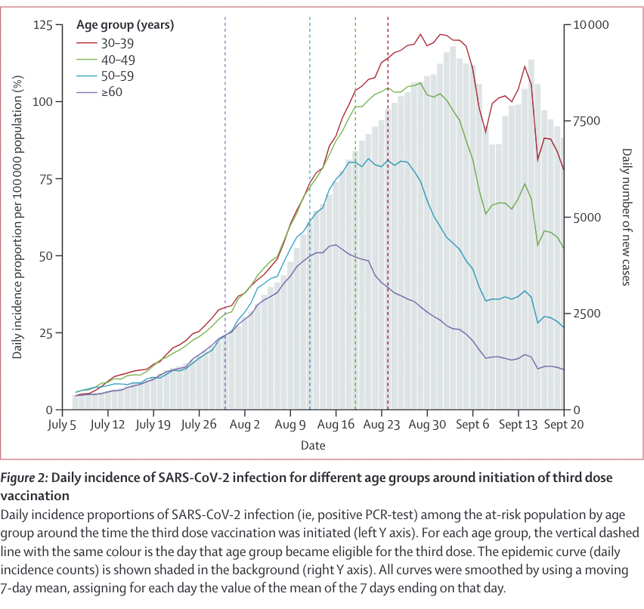

Slide 15
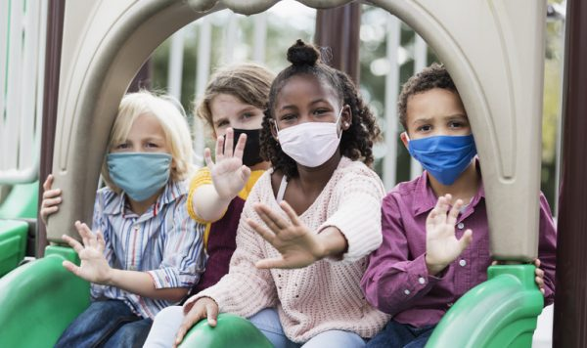
Childhood COVID19 Vaccine (and for most vaccines) rationale
Children act as a reservoir for disease
Impact of COVID on education, childcare, ability of caregivers to work
Impact of social isolation on mental health
Increasing COVID disease in children
Increase in childhood morbidity and mortality from COVID

Slide 16
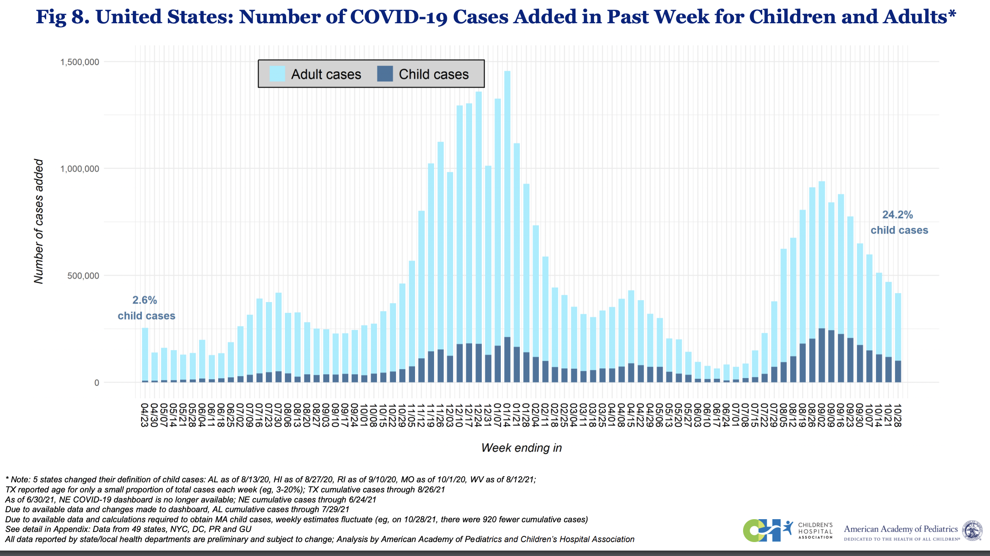

Slide 17
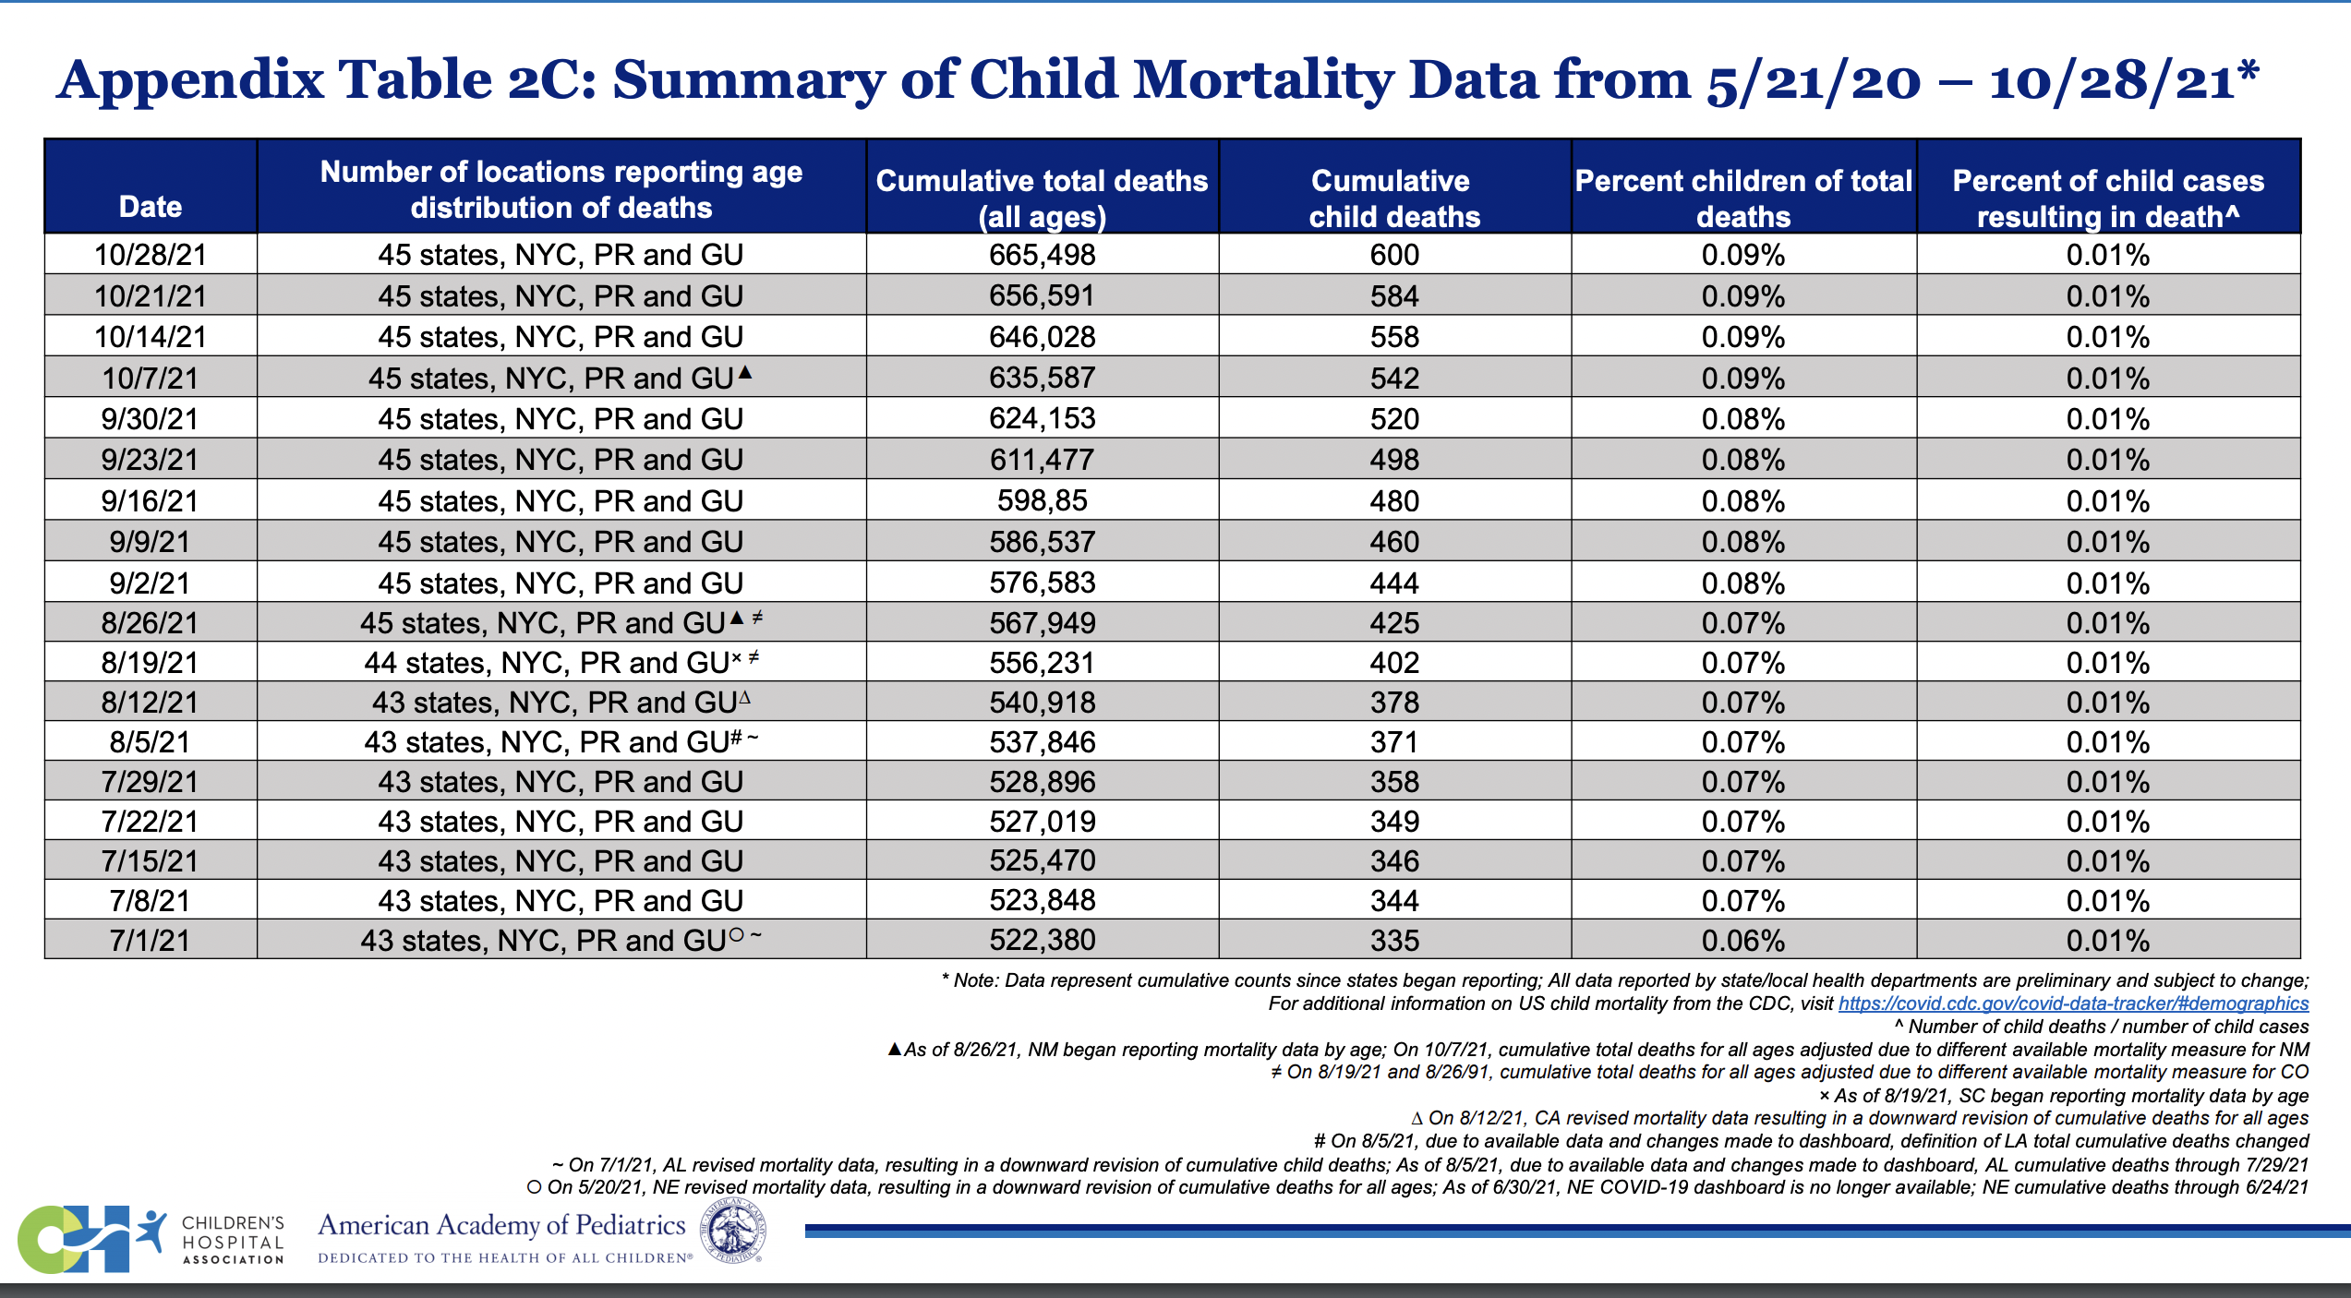

Slide 18
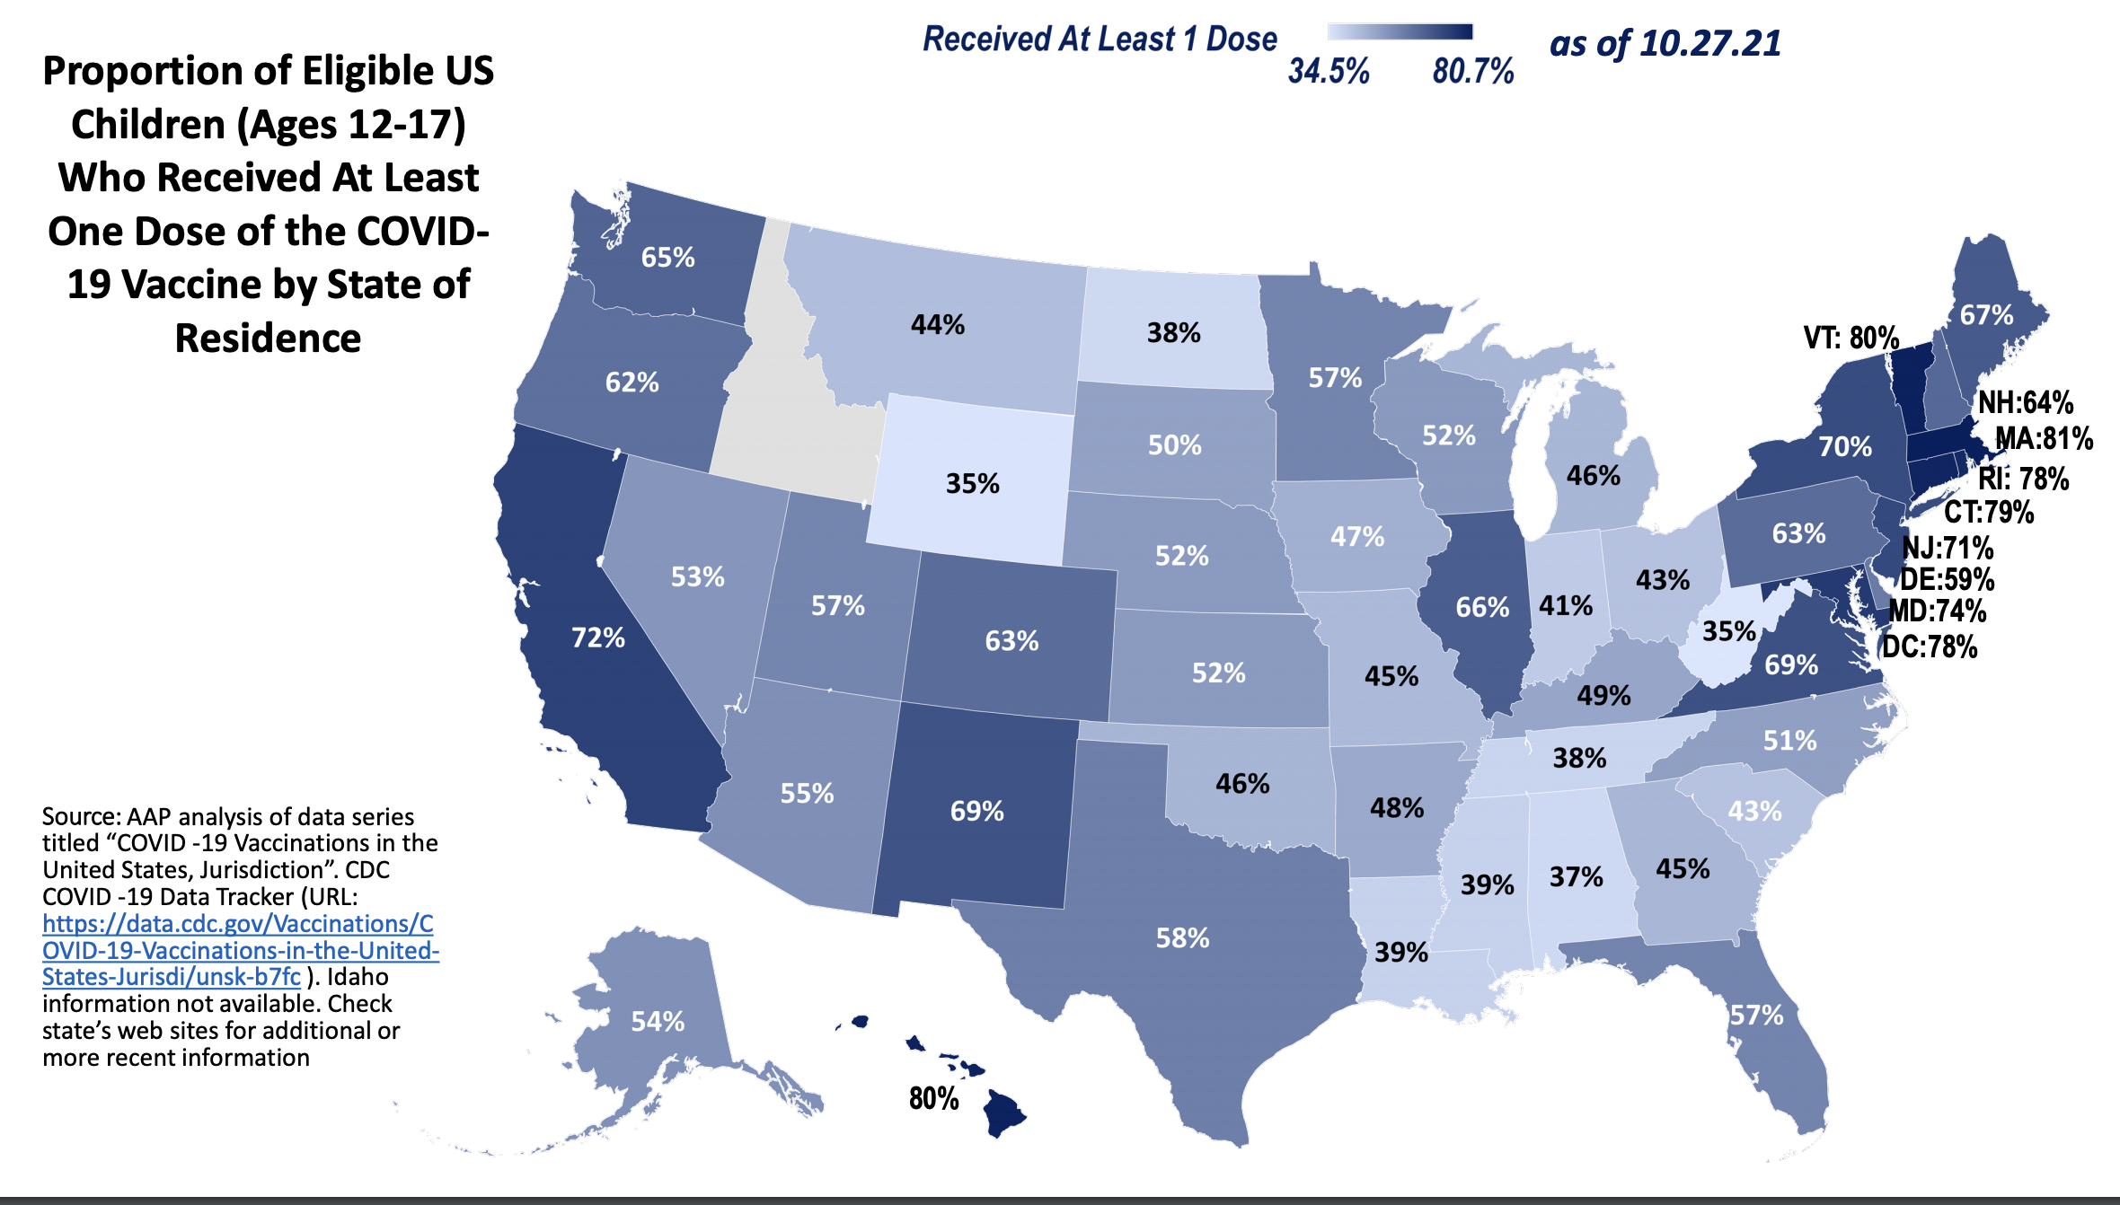

Slide 19
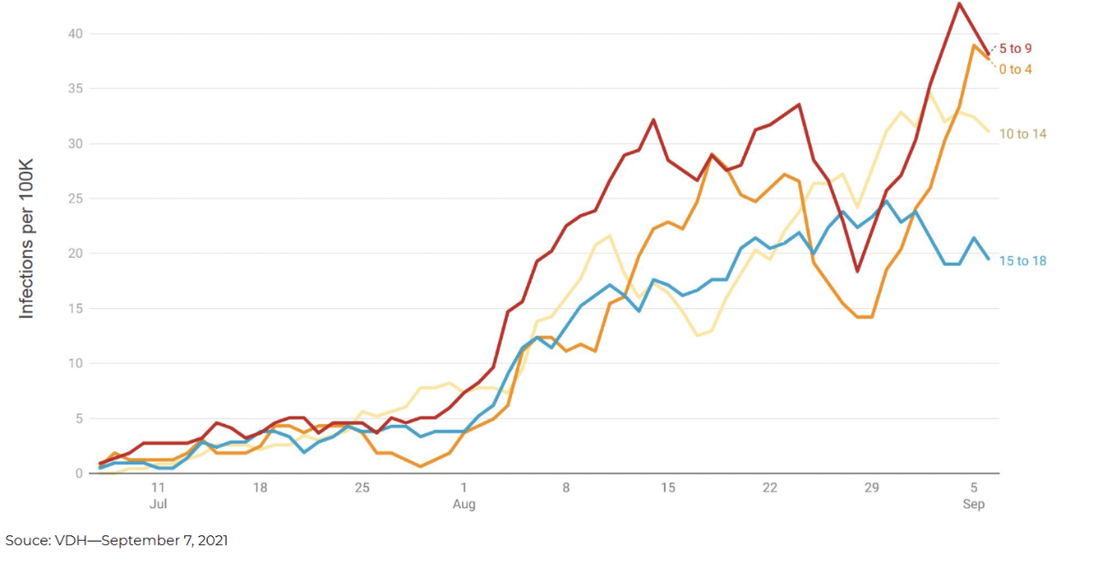
Myocarditis risk

Slide 20
Trial of Pfizer in 5-11 year olds.
2250 participants age 5-11 with 1518 receiving 10 micrograms ( 1/3 of adult dose) and 750 receiving placebo dose
Followed at least 2 months post vaccine
Anitbody/neutralizing response similar to those 12 and over with the higher dose
Vaccine efficacy of 90.7% against any COVID infection
No increased safety concerns – more and ongoing data is being collected in clinical trials in children
Expect EUA today or tomorrow

Slide 21
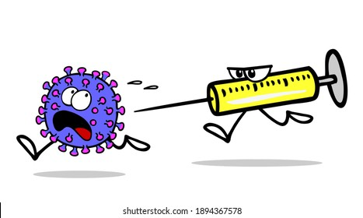
Vaccine delivery in children in Springfield
Schools
Mobile units
Pharmacy
Physician office
Vaccine clinics

Slide 22
How does the FDA monitor safety
VAERS system of data collection
Over 7 billion doses of COVID vaccines have been delivered across the world
If trend is seen may decide to halt administration of vaccines
Have to compare to baseline incidence rates of disease

Slide 23
Myocarditis
Inflammation in the heart muscle causing pain and sometimes shortness of breath, decreased energy level.
Israeli safety data suggests that rare post-vaccination myocarditis peaks in ages 16-19 males. Decreases in 12-15 year olds.
A conservative estimated risk is 20 cases per one million children and adolescents that receive 2 doses of vaccine.
77% of cases considered mild and have not required hospitalization. No confirmed pediatric deaths
4000 children age 5-12 yo in the US have been hospitalized with COVID for every 1 million with COVID infections.

Slide 24


